Slide 1
Lab 2

Slide 2
Data processing and modeling

Slide 3
General Approach for Data Processing
Data Cleaning and Imputation
Data Transformation
Data Reductoin

Slide 4
Goals of Data Processing
Turn raw data into model-ready data
Remove errors, missing values, and noise
Make features comparable and numerically stable
Reduce redundancy and unnecessary complexity

Slide 5
Disscussion
Ways to deal with missing or incorrect values?
How to choose appropriate methods to deal with missing or incorrect values

Slide 6
Data Processing
To file lab2_processing.ipynb

Slide 7
Data Processing
DYO:
Play around with lab2_processing, ask questions
Break:
From 11:00 -11:15

Slide 8
General Approach for Modeling
Data Preparation
Training Model
Creating a Pipeline
Evaluating
Checking Generalization (Overfitting vs Underfitting)

Slide 9
Data Preparation
Simple Split
Suppose we have enough data…
We’ve selected the right training data…
We’ve picked the features we want the model to learn from…
But how do we know our model will generalize well?
K-Fold Validation
Split your data randomly into k equal size parts.
For each part, hold one back as a test set and train on the k − 1 remaining parts, evaluate on the part you held back.
Report the average evaluation.

Slide 10
K fold cross validation
If k = 5, then you have 5 parts T1, . . . , T5 you would run 5 training runs
Train on T1,T2,T3,T4 evaluate on T5.
Train on T1,T2,T3,T5 evaluate on T4.
Train on T1,T2,T4,T5 evaluate on T3.
Train on T1,T3,T4,T5 evaluate on T2.
Train on T2,T3,T4,T5 evaluate on T1.
Good values of k are 5 or 10. Obviously the larger k is the more time it takes to run the experiments.

Slide 11
After K fold
Cross validation only returns a value that is a prediction of how well the model will do on more data.
k-fold cross validation without ensemble methods only tells you which model is better. It does not give you a trained model.
Once you have chosen the parameters and model, repeat the process to get an actual trained model.

Slide 12
Training Model
To file lab2_modeling.ipynb

Slide 13
Terminology
Type of classification outputs:
True positive (m11): Example of class 1 predicted as class 1.
False positive (m01): Example of class 0 predicted as class 1. Type 1 error.
True negative (m00): Example of class 0 predicted as class 0.
False negative (m10): Example of class 1 predicted as class 0. Type II error.
Total number of instances: m = m00 + m01 + m10 + m11
Error rate: (m01 + m10) / m
If the classes are imbalanced (e.g. 10% from class 1, 90% from class 0), one can achieve low error (e.g. 10%) by classifying everything as coming from class 0!

Slide 14
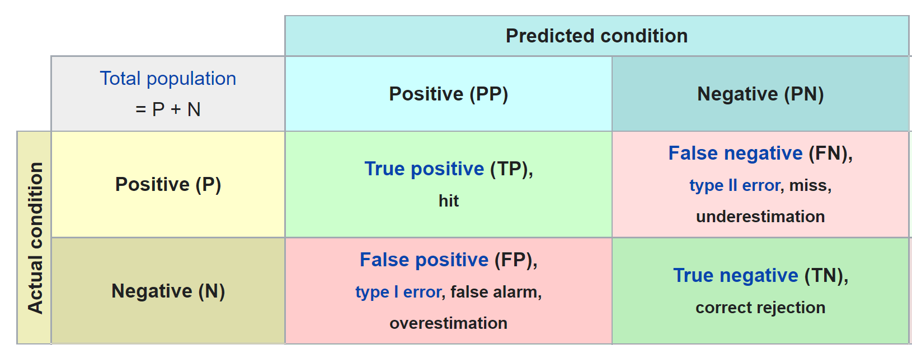
Evaluating: Confusion Matrix
[ TrueNegative FalsePositive
FalseNegative TruePositive ]
Do this for every class – multi class classification problems
Format not consistent, be careful

Slide 15
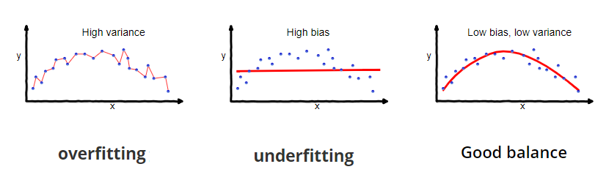
Overfitting vs Underfitting
Over-fitting: Training accuracy is higher (error is lower) than testing accuracy
Model explains the training data very well, but poor generalization
Under-fitting: Both accuracies are unacceptable low

Slide 16
Modeling
DYO:
Play around with lab2_modeling, ask questions

